Slide 1

Introduction to Entrepreneurship
Dr. Zunaira Saqib

Slide 2

Week 10: Marketing and Marketing Research
Marketing Strategies: Understanding how to do marketing research to validate your start-up

Slide 3

Marketing for Start ups
Promoting and selling products or services via various platforms
Issues for startups
Limited budget
Too many platforms
Not trained to market

Slide 4
Marketing Mix
Product
Price
Place
Promotion.

Slide 5

Brand Identity: Branding Your Product/ Service
Choose your business name
Simple, easy to remember, relatable
Write your slogan
Define / explain the value you are delivering
Choose the look of your brand (colours and font)
Relate with your audience + Represent you
Design your brand logo
Creative and memorable
Apply your branding across your business.

Slide 6


Slide 7


Slide 8


Slide 9


Slide 10


Slide 11

Product
Website
Emails
Social Media
Content / Blogs

Slide 12

Website
Static Website
Landing Page
E-Commerce Website
Platforms
Wix
Wordpress
Shopify
Weebly
Hubspot

Slide 13
App Prototype
Come up with essential features
Select one you want to demonstrate
Use platforms
Figma
Andromo
Mockitt

Slide 14
Social Media
Setup
Facebook (Business Suit)
Instagram (Business Suit)
LinkedIn (Company’s Page)
Design
Use Canva to design posts
Building the hype
Coming soon post
Product features
Take audience feedback / Team intro

Slide 15

Content marketing
Blog/content marketing is reaching your target audience to direct attention towards your business.
How
Write short articles
Use Hashtags / trending topics
Share
Reddit
LinkedIn Articles
Quora

Slide 16

7% Presentations – 17th May, Friday
09:00am start – Groups present in Slots
5-7 Judges from Startup eco system
5 Minutes Ppt
Company, Logo, Tag Line
Problem and Solution (20%)
Market Research, Industry Analysis and USP(20%)
Funding need and why (30%)
Prototype Presentation/ Show (30%)
5 Minutes Q and A
To the point and short answers
Professionalism (Attire and Attitude)

Slide 17
8% Business Plan – 24th May, Friday.
Hard copy + Soft copy
Business Plan + Excel File
Word Limit 5000 (If needs exceeding, Discuss)
Should Include
Introduction, Company and Team Description
Problem and Solution (20%)
Market Research, Industry Analysis, Competitors Analysis and USP (10%)
Business Model Canvas (10%)
Target Market and Customer Personas, Social Media Setups (100 likes) and Static Website (Include Links for Checking) (25%)
Financial Evaluation of One Year Including Funding Need and Why (20%)
Prototype Links / Presentation/ Show (25%)

Slide 18

Marketing Research
Validating your startup

Slide 19

Marketing Research
The process of evaluating the viability of a new service or product through research conducted directly with potential customers.

Slide 20

Marketing Research Process
Define the Problem / Opportunity
Develop Research Plan
Collect Data
Analyse Data
Report Findings
Take Action

Slide 21
1. Defining the Problem / Opportunity
Clearly identify and define the problem you are trying to solve
Example
Confirming consumers’ biggest pain point and whether your product meets their needs (A New School)
Tracking and predicting relevant industry trends (Delivery Services)
Determining consumer spending capacity for a product/service (Burger vs. Haleem)

Slide 22
Define Problem / Opportunity
Example of Opportunity
You are trying to launch a new product or service.
Example of Problem / Opportunity
Awareness of your company and its products or services is low.
The market is familiar with your company, but still is not doing business with you.
Your company has a poor image and reputation.
Your goods and services are not reaching the buying public in a timely manner.

Slide 23

How to Know the Problem Statement is Okay?
Clear:
Is the problem statement easy to understand?
Specific:
Specific enough to guide your research efforts?
Relevant:
Does the problem address a significant issue?
Measurable:
Can the research outcome be measured?

Slide 24

Defining Problem / Opportunity : Example
To address the transportation challenges faced by women in Pakistan, we aim to explore the feasibility and acceptance of a women-only taxi service. We will focus on understanding the demand for such a service, perceived value in terms of safety and convenience, competitive landscape, pricing sensitivity, and cultural factors influencing acceptance focusing initially in three major cities of Pakistan.

Slide 25
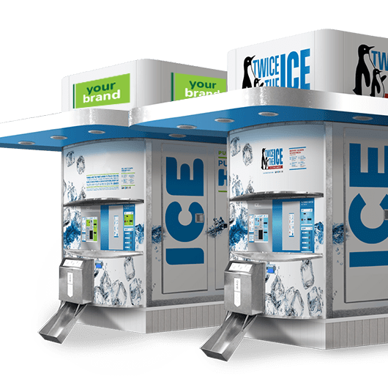
Defining Problem / Opportunity : Example
We aim to assess the feasibility and acceptance of introducing ice machines in the market. Our focus will be on understanding the demand for ice, perceived value in terms of quality and convenience, competitive landscape, pricing sensitivity, and cultural factors influencing acceptance. The initial phase of this research will concentrate on three major cities in Pakistan.

Slide 26
2. Develop Research Plan
Define Target Market
Population: 20 Million Across Pakistan of Working Women
1% of Population: 20,000
1% of Sample Size: 200
Region: Islamabad
Demographics
Age, Gender, Income Status
Psychographic
Interests and Attitudes
Decide on Research Methods
Primary Research
Secondry Research

Slide 27
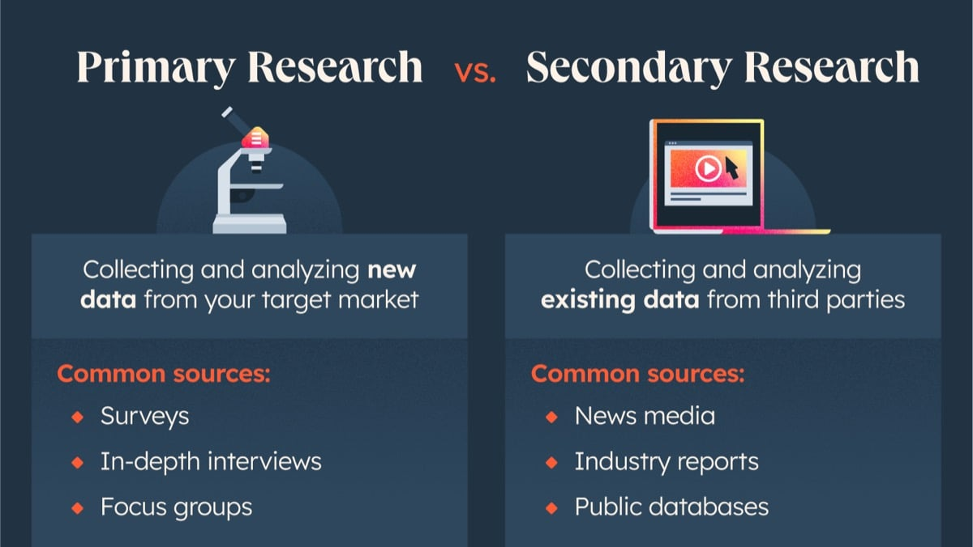

Slide 28
3. Collect Data
Quantitative Research
What?
Numerical
Discover
Methods
Polls
Surveys
Questionnaires
Qualitative Research
How and Why?
Words
Understand
Methods
Focus Groups
Interviews
Field Observation

Slide 29
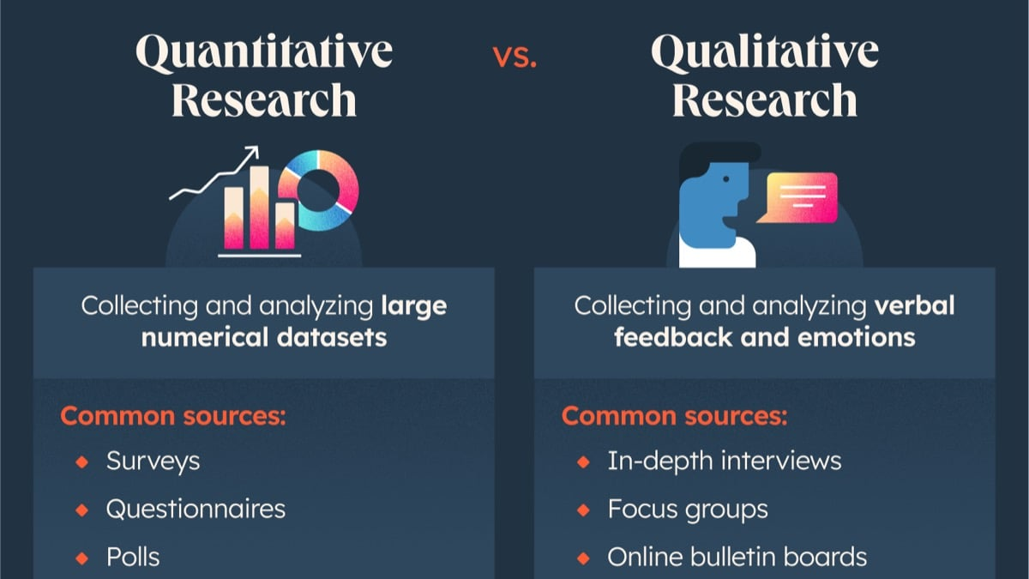

Slide 30
Example Questionnaire Questions
What frequency of taxi use do you currently have?
a) Daily
b) Weekly
c) Monthly
d) Rarely or never

Slide 31
Example Questionnaire Questions
How important is safety as a factor when choosing a transportation service?
a) Extremely important
b) Very important
c) Somewhat important
d) Not important

Slide 32
Example Questionnaire Questions
Are you aware of any existing women-only taxi services in your area?
a) Yes
b) No

Slide 33
Example Questionnaire Questions
If yes, how satisfied are you with the existing women-only taxi services?
a) Very satisfied
b) Satisfied
c) Neutral
d) Dissatisfied
e) Very dissatisfied

Slide 34
Example Questionnaire Questions
How much of a premium, if any, would you be willing to pay for a women-only taxi service compared to a mixed-gender service?
a) No premium
b) Up to 10%
c) 11-20%
d) More than 20%

Slide 35
Example Questionnaire Questions
What is your age group?
a) 18-24
b) 25-34
c) 35-44
d) 45-54
e) 55 and above

Slide 36
Example Questionnaire Questions
In which city do you primarily use taxi services?
a) Karachi
b) Lahore
c) Islamabad
d) Other (please specify)

Slide 37
Example Interview Questions
Can you share your experiences and challenges when it comes to using transportation services in Pakistan, especially taxis?
In your opinion, how important is the aspect of safety when using transportation services, and what specific safety concerns do you have?
If a women-only taxi service were available, what specific features or services would you expect to see that would make you choose it over other options?
Based on your experiences with existing transportation services, what improvements or changes would you suggest for a women-only taxi service to better meet the needs of women in Pakistan?

Slide 38
4. Analyze Data
Quantitative Data
Excel Formulas
Simple %
Qualitative Data
Identify Keywords
Identity Themes

Slide 39
5. Report Findings
Quantitative Data
Qualitative Data
Report in numbers
Graphs and Figures
Answer What and How Much?
Report in words
People’s emotions
Answer Why

Slide 40
5. Report Findings
Quantitative Data
Qualitative Data
70% Working Women Willing to Use Taxi Service for Women in Islamabad
Willing to Pay 70-100 PKR per km
Based in Islamabad
Concerned with Safety with Other Services
"I often find it challenging to use regular taxis, especially during late hours. Safety concerns and uncomfortable experiences with male drivers have been recurring issues for me."
Feel Safe and Secure with Other Women
Concerned about Driving Skills of Women Drivers
Concerned about the Immediate Availability

Slide 41
6. Take Action
We can launch a test service in Islamabad only.
We will only have 10 taxis to start with.
We will have issues of finding women drivers.
Not many women drive.
Do we make contracts with driving schools?
We must make sure of safety.
How? Document verification?
App would be too expensive.
WhatsApp group?

Slide 42
Conduct a Short Marketing Research Activity
Within Class

Slide 43
Next Week: Discussion of Assignments – One Final Idea
Quiz 3

